Slide 1
RSM222 Management Accounting 1
Elisa Zuliani

Slide 2
How to reach me…
About Me:
Contact Information:
Email: elisa.zuliani@rotman.utoronto.ca
Please put RSM222 in the Subject Line
Office Hours (No “Set” Times)
ZOOM (Can set up appointment that day or within 24 hours)

Slide 3
Course Outline Discussion
Description | Due Date | Weight
Weekly Connect Homework | Ongoing | 10%
Class Participation | Ongoing | 5%
Cost Assignment (Individual) | October 24th @10pm | 5%
Current Events Journal (Group) | October 21st@10pm (week 3-5 journals) November 30 @10pm (week 7 – 11 journals) Submit in Quercus dropbox | 15%
Midterm | Friday, October 17 7 – 9 pm (tentative) | 30%
Final Exam | TBD | 35%
 |  | 100%

Slide 4

COURSE OUTLINE OVERVIEW
Course Outline Overview

Slide 5
Chapter 1
Managerial Accounting and the Business Environment

Slide 6





\
Contrast Financial and Management Accounting
RSM 222
Managerial accounting is concerned with providing information to inside managers to help make decisions.
Managerial accounting provides tools to assist management in making decisions and evaluating the effectiveness of those decisions.
INTERNAL MANAGERS & DECISION MAKERS
MANAGEMENNT ACCOUNTIG
EXTERNAL STAKEHOLDERS
RSM 219
FINANCIAL ACCOUNTING

Slide 7
Role of a Management Accountant
The role of managerial accountants is
Identification,
Measurement, and
Management
Managerial accounting is broad and straddles competitive strategy, organizational economics, finance, operations management and organizational behavior.
of key operational and financial value drivers (Institute of Management
Accountants).
Managerial accountants are
Problem Solvers (i.e., Provide information for decision making);
Scorekeepers (i.e., Measure performance of individuals, groups and processes),
Attention Directors (i.e., strategic cost management).

Slide 8
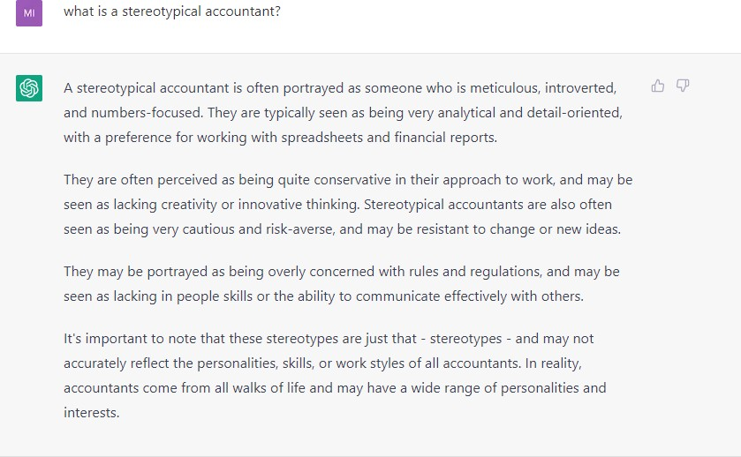


Management Accountants are NOT the Sterotypical Accountant
Perform the tasks that aids the company to make the right decisions. (CIMA)

Slide 9
Contrast Financial and Management Accounting
Audience
Financial: External (and Internal): Stockholders, creditors, tax authorities….
Management: Internal: Managers
Purpose
Financial: Valuation and stewardship assessment.
Management: to make decisions, communicate strategy, evaluate performance,
control/align behavior.

Slide 10
Contrast Financial and Management Accounting
Timeliness
Financial: Historical → Regular intervals; relatively long reporting periods
Management: Current and future oriented, but also historical for control
Reporting periods depend on need
Regulation
Financial: Regulated → Rules driven by GAAP and government authorities
Management: No regulations
Systems and information determined by management to meet strategic and operational needs; not required by law

Slide 11
Contrast Financial and Management Accounting
Qualitative Characteristics of Information
Financial: Auditable, Reliable
Management: Not subject to audit, could be more subjective
Scope
Financial: Highly aggregated; report on entire organization
Management: Not aggregated; informs local decisions and actions

Slide 12
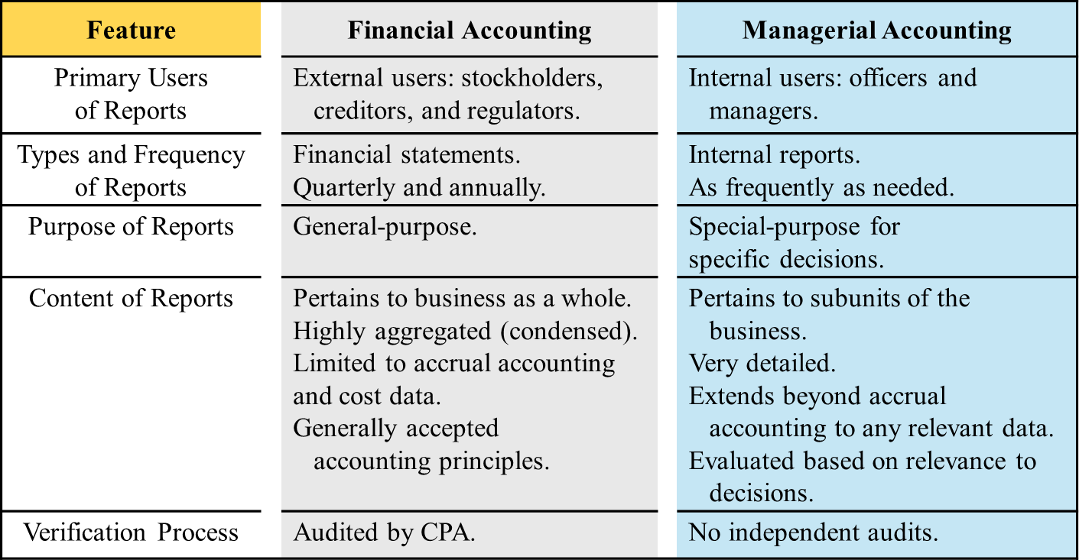

Putting it all together : Financial and Management Accounting
To RSM222
Historical vs. Future Perspective

Slide 13



Work of Management
Planning
Controlling
Directing & Motivating

Slide 14
Planning
Identify alternatives
Select alternative that does the best job of furthering organization's objectives
Develop budgets to guide progress toward the selected alternative

Slide 15
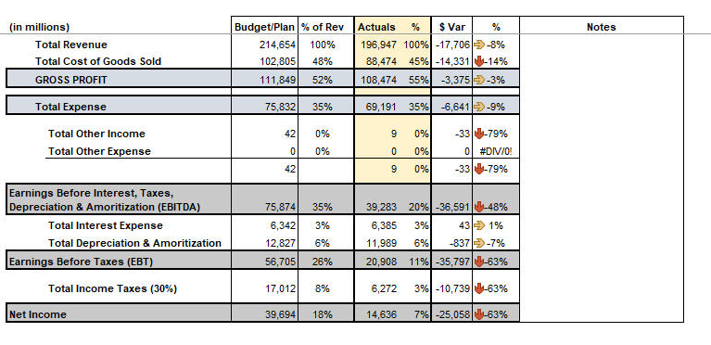
Planning
Planning

Slide 16
Planning and Control Cycle
Formulating long and short-term plans (Planning)
Managerial accounting encompasses more than reporting numbers.
Managerial accounting includes partnering with other managers and departments and providing tools and reports to those areas.
Comparing actual to planned performance (Controlling)
Implementing plans (Directing and Motivating)
Decision Making
Measuring performance (Controlling)
Good decision making is rarely done by intuition. Consistently good decisions result from diligent accumulation and evaluation of information.

Slide 17
Directing & Motivating
Directing and motivating involves managing day-to-day activities to keep the organization running smoothly
Employee work assignments
Routine problem solving
Conflict resolution
Effective communications

Slide 18
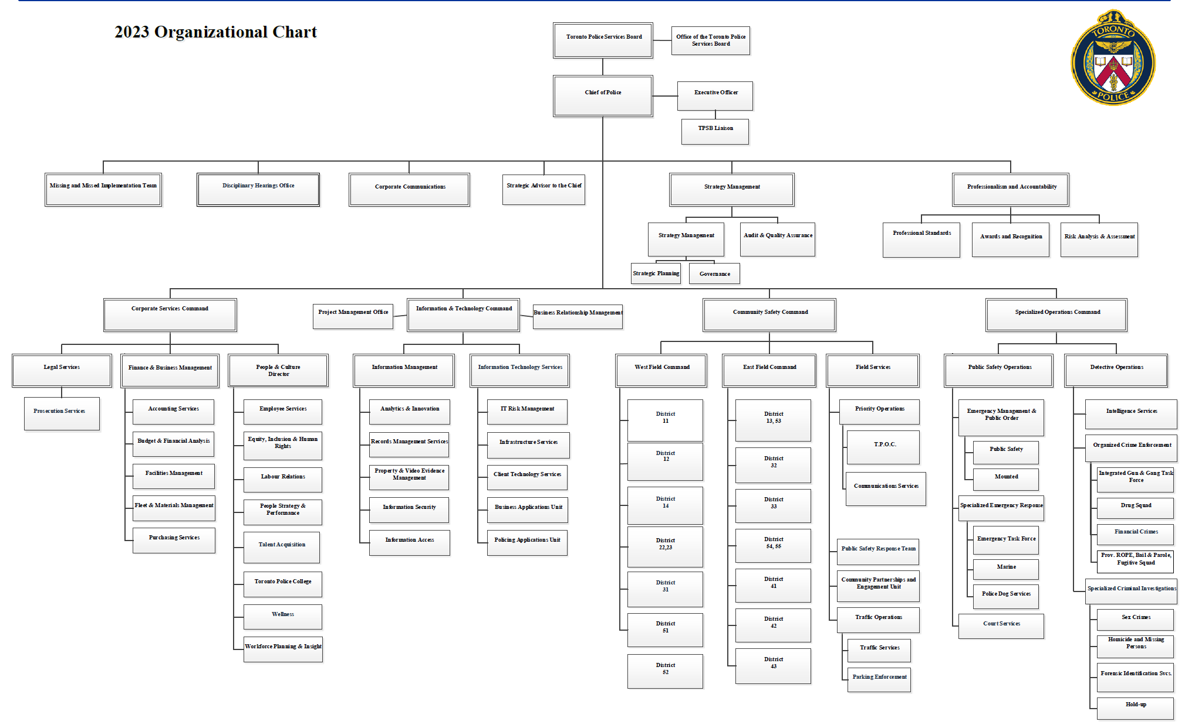
Role of Management Accounting
Organizing

Slide 19


Decision Making
What went into this?
News Release
“As part of its initiatives to drive long-term profitable growth and enhance shareholder value, and after careful consideration of all reasonably available options, the Company also announced today it has decided to discontinue support for Nordstrom Canada's business operations.”
"Despite our best efforts, we do not see a realistic
path to profitability for the Canadian business”
“The Company expects to report
approximately $300 million to $350 million of pre-tax charges related to the wind-down and is expected to result in an approximately $400 million decline in total Company net sales and a $35
million improvement in total Company EBIT in fiscal 2023, relative to fiscal 2022, excluding the aforementioned charges associated with the wind- down.”
Theme of Course: Managers make decisions, and therefore need information.
19

Slide 20

Controlling
The control function ensures that plans are being followed
Feedback in the form of performance reports that compare actual results with the budget are an essential part of the control function

Slide 21
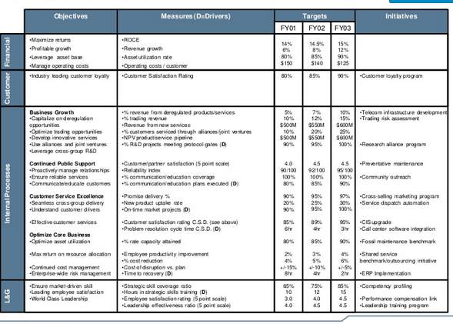
Role of Management Accounting
Controlling

Slide 22
Corporate Governance
Board of Directors
Incentives & Monitoring for
Top Management
To pursue objectives of
Shareholders

Slide 23
Corporate Governance
An effective corporate governance system should also protect the interest of the company’s other stakeholders
Employees
Customers
Creditors
Suppliers
And the communities in which the company operates

Slide 24
Corporate Social Responsibility
Corporate social responsibility (CSR) is a concept whereby organizations consider the needs of all stakeholders when making decisions
Customers
Employees
Suppliers
Communities
Shareholders
Environmental & Human Rights Advocates
CSR extends beyond legal compliance to include voluntary actions that satisfy stakeholder expectations

Slide 25
Ethics
Ethical standards in business are essential for a smooth functioning advanced market economy
Without ethical standards in business, the economy, and all of us who depend on it for jobs, goods and services, would suffer
Abandoning ethical standards in business would lead to a lower quality of life with less desirable and services at higher prices

Slide 26
Ethical Conduct and Social Responsibility
Virtually all managerial accounting practices developed to maximize profits
Ethical behaviour involves choosing actions that are right, proper and just
“teaching ethical decision making and principled reasoning” – Michael Josephson
For moral or ethical education to have meaning, there must be agreement on the values that are considered “right”
core values referred to include honesty, integrity, promise keeping, fairness, respect for others, responsible citizenship, accountability
Subprime mortgage crisis highlights the importance of ethical considerations as some banks tried to increase profits by lending more money than people could reasonably afford

Slide 27
Wells Fargo Scandal
Wells Fargo Scandal
The scandal resulted in $185 million in fines and resignation of CEO John Stumpf
Warren Buffet blames the fraud scandal at Wells Fargo on a case of”
Misplaced incentives
“huge, huge error” of ignoring whistleblowers
Buffet said “You have to be very careful what you incentivize”

Slide 28
An Organization’s Mission, Goals and Strategies affect Management Accounting
To compete effectively, an organization must have consistency among:
Mission
Goals
Strategies
Cost leadership strategy
Product or service differentiation strategy
Market niche strategy
Balanced approach

Slide 29
Key Relationships
Customers
Activities
Resources
Costs

Slide 30
Course Map
UNDERSTANDING PROFITABILITY
(Lecture 1 to 6)
STRATEGIC DECISION MAKING
(Lecture 8 - 11)
EVALUATING PERFORMANCE
(Lecture 12 )
COST DEFINITIONS
BUDGETING & PLANNING
PERFORMANCE MEASUREMENT & COMPENSATION
COST BEHAVIOUR & COST ANALYSIS
VARIANCE ANALYSIS
COSTING ALLOCATION & COSTING METHODS
RELEVANT COSTS
CAPTAL BUDGETING DECISIONS
Management accounting is extremely important for businesses because it allows them to translate hard data about their finances into reports that can be analyzed and used for strategic business decisions

Slide 31
Chapter 2
Cost Terms, Concepts, Classification and Behaviours

Slide 32

Cost versus Price versus Value
the cost of your product or service is the amount you spend to produce it
the price is your financial reward for providing the product or service
the value is what your customer believes the product or service is worth to them
Every business needs to cover its costs in order to make a profit. Working out your costs accurately is an essential part of working out your pricing.

Slide 33
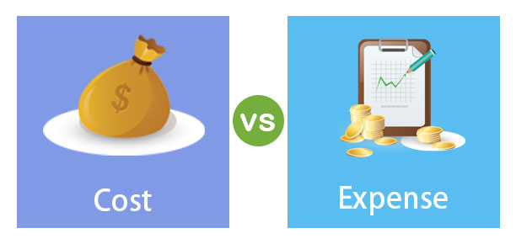
Cost vs. expense
Cost vs. expense
Cost
An economic value sacrificed to create another economic benefit [economic meaning]
Expense
A resource being consumed / used under accrual accounting
A cost that is recognized to match revenue generated [accounting meaning, based on matching principle]

Slide 34

Cost
Expired costs = expenses
Accumulating costs – the way that costs are measured and recorded
Versus
Assigning cost – the way that a cost is linked to some cost object
Cost object – something for which a company wants to know the cost of

Slide 35
Cost Objects
Organization | Cost Object
Royal Bank - credit card services | Cost of each card
University of Toronto | Cost of each program
Air Canada | Cost of flight
Walt Disney | Cost of producing films
Loblaws | Costs of each store location
Discussion: What costs went into these different objects?

Slide 36

Let's practice….
Discussion: What costs went into this beautiful burnt orange coat?

Slide 37

Let's practice….
Now that’s a lot of costs…
Costs must be classified into different categories to help to assist with strategic decision making
- Refer to class handout

Slide 38
Product vs. Period Costs

Slide 39


Product vs. Period Costs
Product Costs
Period Costs
Manufacturing costs
Costs relate directly to making the product
Cost assigned to inventory
Non-manufacturing costs
Costs not directly elated to making the product
Cost expensed when incurred

Slide 40



Cost Definition & Classification (Cont’d)
Cost | Definition
Product Costs | Include all costs involved in purchase or manufacture of goods.
Period Costs | All costs that are expensed on the income statement in the period in which they are incurred or accrued. Selling (marketing) and administrative expenses are period costs.
3. PRODUCT vs. PERIOD COSTS
Necessary distinction for external financial reporting
Costs relate directly to making the product.
Costs not directly related to the product.
Cost assigned to
inventory.
Cost expensed when
incurred.

Slide 41




Costs and Financial Reporting
Income Statement
Balance Sheet
Raw Materials Work in Process Finished goods
Operating Expenses
Selling & Admin Expenses
INVENTORY
COGS

Slide 42



Classification of Inventory
Raw Materials
WIP
Work-in-process
Finished Goods
COGS
Inventory (Asset)
Expense

Slide 43









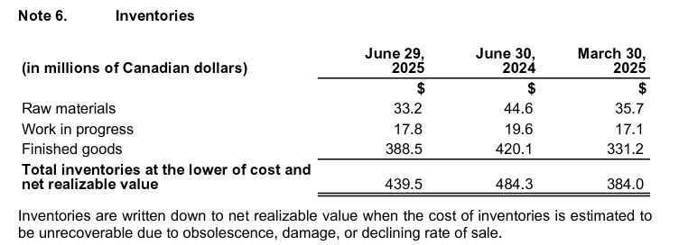

Classification of Inventory
Inventorial Costs: Costs that end up on the balance sheet as part of inventory
Raw Materials
WIP
Work-in -process
Finished
Goods
COGS
Inventory (Asset)
Expense

Slide 44
Classification of INventory

Slide 45
Classification of Inventory
When
Material is
Used in
manufacturing
Raw Materials
1000 | 500
WIP
500 750 (Direct Labour) 250 (Manufacturing Overhead) | 1,500
When
Manufacturing
is finished
Finished Goods
1,500 | 1,500
When
sold
COGS
1,500
Raw Material $1,000
Cash $1,000
Raw Material $500
WIP $500
WIP $1,500
Finished Goods $1,500
Finished Goods $1,500
Cost of Goods Sold $1,500

Slide 46
Gross Margin
Selling Price
Product Costs
GM
=
-

Slide 47
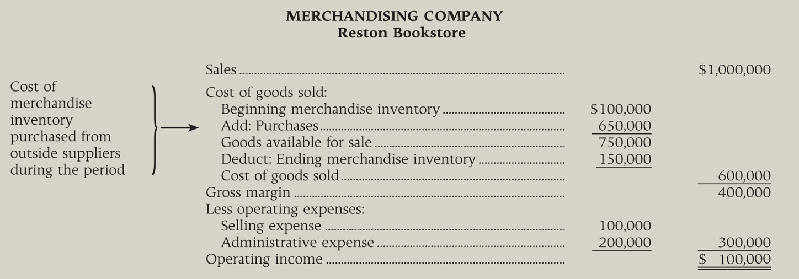
Comparative Income Statements (see Ex 2-2)

Slide 48
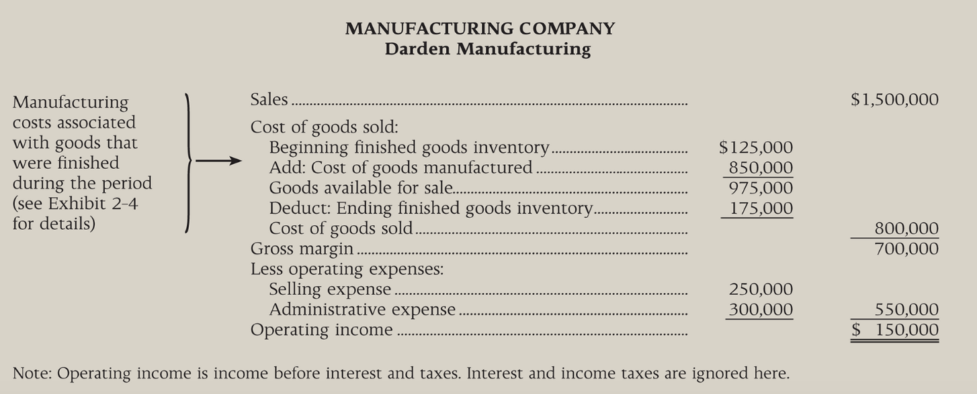
Comparative Income Statements (see Ex 2-2)

Slide 49
Basic Equation for Inventory Accounts
Basic Equation for Inventory Accounts
Beginning Balance
Additions to Inventory
Ending Balance
Withdrawals from Inventory
+
=
+

Slide 50
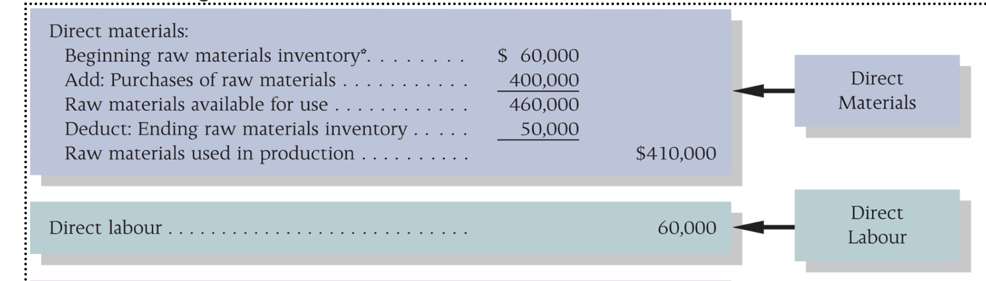
Darden Manufacturing Schedule of Cost of Goods Manufacturing (see Ex 2-4)

Slide 51
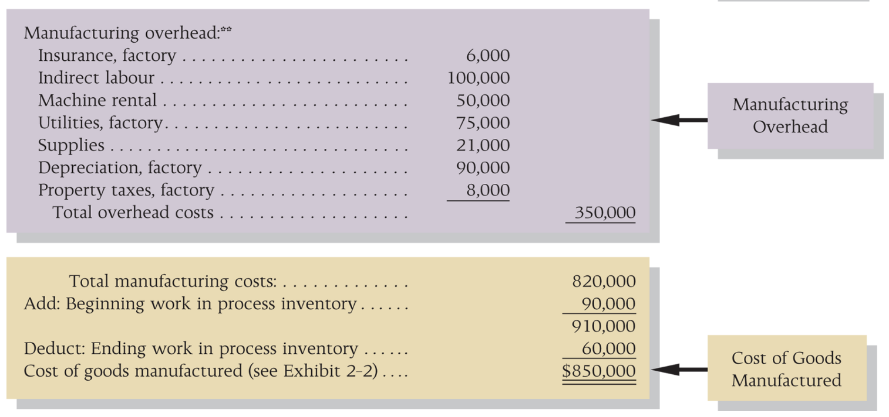
Darden Manufacturing Schedule of Cost of Goods Manufacturing (see Ex 2-4)

Slide 52
Cost Behavior
Variable vs. Fixed Costs : Definitions

Slide 53





Cost Behaviour
If I produce one coat, what will be the impact on the following costs?
Rent for clothing factory
CEO Salary
Fabric
Wages of Factory Workers
Wages of Designer
Utilities

Slide 54

Cost Behaviour
If I produce coats (entire product line), what will be the impact on the following costs?
Rent for clothing factory
CEO Salary
Fabric
Wages of Factory Workers
Wages of Designer
Utilities

Slide 55
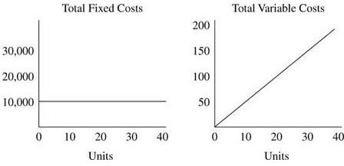


Cost Definition & Classification (Cont’d)
Cost | Definition
Variable Costs | A cost that varies in total, in direct proportion to changes in the level of activity.
Fixed Costs | A cost that remains constant in total, regardless of changes in the level of activity within the relevant range.
Mixed Costs | A cost that has a component that is fixed and a component that is variable.
4. VARIABLE vs. FIXED COSTS
Cost Structure: Proportion of variable vs. fixed costs in a company and will depend on the organization

Slide 56
Variable Costs
Total dollar amount varies in direct proportion to changes in the activity level
ACTIVITY BASE
Units produced
Miles Driven
Machine Hours
Labour Hours

Slide 57
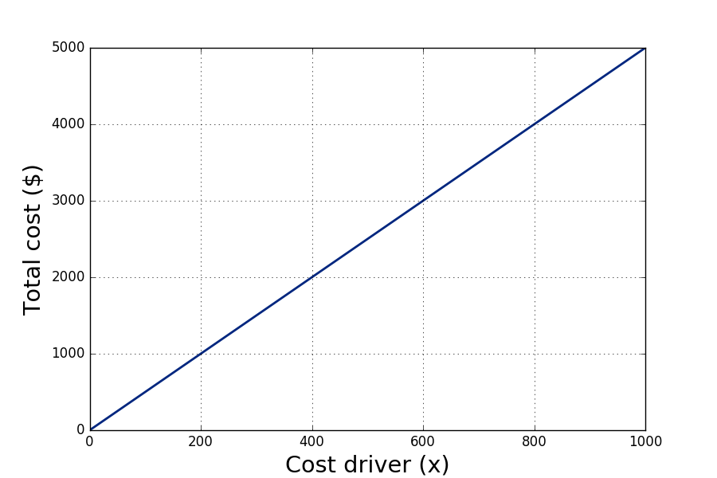
Variable Cost
Fixed cost: $0
Unit variable cost: $5
Total cost function:

Slide 58
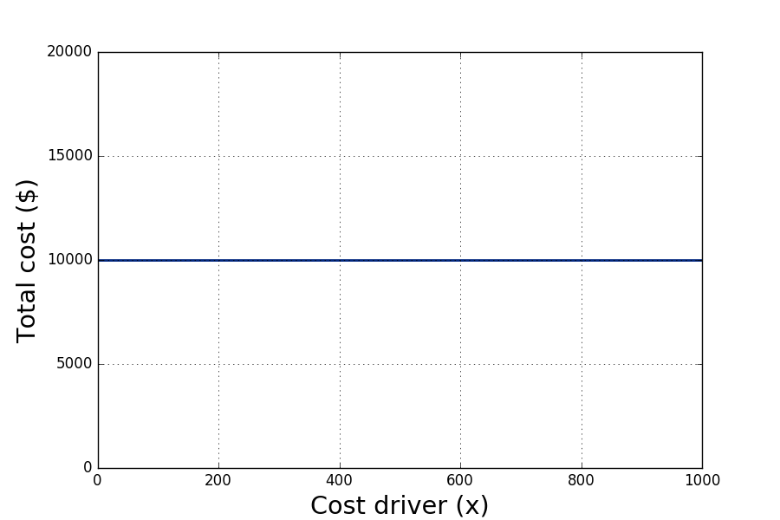
Fixed Cost
Fixed cost: $10,000
Variable cost: $0
Total cost function:

Slide 59
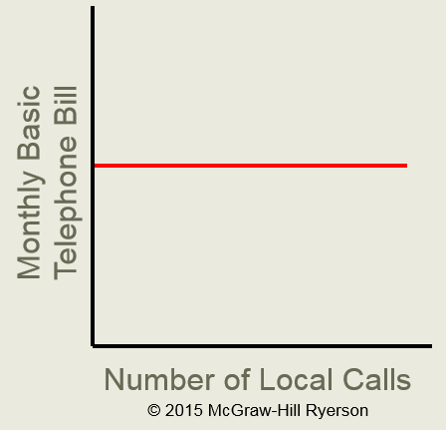
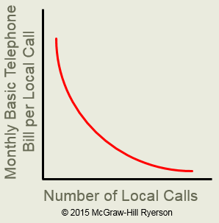
Profit maximization
Fixed Costs
Fixed costs remain constant in total but decrease on a per unit basis

Slide 60




True Variable Cost
The amount used during a period varies in direct proportion to the level of production activity.
Types of Fixed & Variable Costs
Step Variable Cost
The cost of a resource that is obtainable only in large amounts and the increase or decrease only in response to fairly wide changes in activity.
Committed Fixed Costs
Cannot be reduced easily without significantly impacting operations and objectives.
Discretionary Fixed Costs
Can be reduced more easily in the short run without significant changes to operations and objectives.
True Variable Cost
The amount used during a period varies in direct proportion to the level of production activity.
Step Variable Cost
The cost of a resource that is obtainable only in large amounts and the increase or decrease only in response to fairly wide changes in activity.

Slide 61
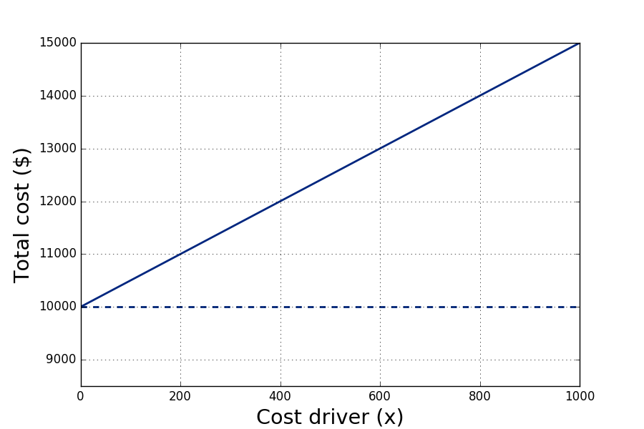
Mixed Cost
Fixed cost: $10,000
Unit variable cost: $5
Total cost function:

Slide 62
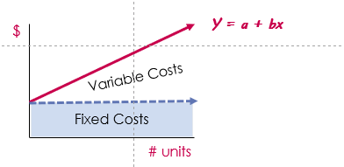
Profit maximization
Mixed Costs
Contains both variable and fixed cost elements.
Y = Total mixed costs
a = total fixed costs
B = variable cost per unit of activity
X = the level of activity.

Slide 63
Cost Behaviour (Variable versus Fixed Costs)
News Release: Sept. 8, 2020
Classification based on the variability of costs
Define cost behaviors using a linear function (of ):
This function approximates total cost within the relevant range:
where is a cost driver, is a fixed cost, and is a
variable cost. ( is a unit variable cost, i.e., marginal cost.)

Slide 64
Mixed Costs – estimating the fixed and variable portion
Let’s use 2 data points:
June Hydro Bill = $15,000
Production = 120,000 units
April Hydro Bill = $14,200
Production = 108,000 units
$15,000 = a + 120,000 b
a = 15,000 - 120,000 b
$14,200 = a + 108,000 b
a = 14,200 - 108,000 b
15,000 – 120,000 b = 14,200 – 108,000 b
800 = 120,000 b – 108,000 b
800 = 12,000 b
B = 0.0667 (variable costs / unit)
y = a + bx
A = y - bx
A = 15,000 – 120,000 * 0.0667
A = $700 (fixed cost)

Slide 65



The Linearity Assumption and the Relevant Range
Economist’s Curvilinear Cost Function
A straight line closely approximates a curvilinear variable cost line within the relevant range.
Relevant
Range
Total Cost
Accountant’s Straight-Line Approximation (constant unit variable cost)
Activity

Slide 66
Contribution Margin
Selling Price
Variable Costs
CM
=
-

Slide 67
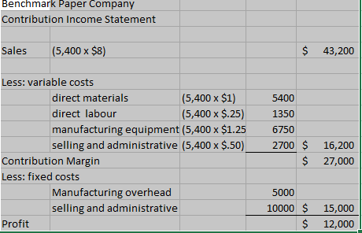
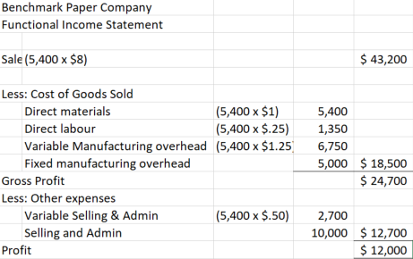
Contribution versus Functional Income Statement

Slide 68
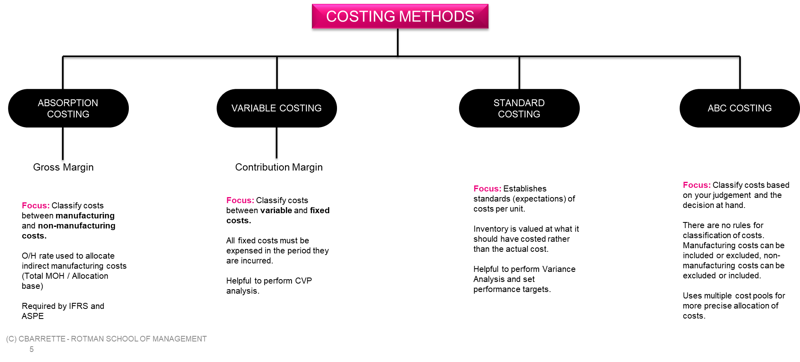
Concept Overview

Slide 69
Key objective for the course:
Develop the ability to determine how much an item cost

Slide 70
Any Questions?

